Slide 1
Information Risk Management
Threat Modelling Techniques for Risk Management:
A Comprehensive Approach to Security
UFCFWN-15-M
D: Faiza Medjek
Notes:
Today we're going to explore threat modelling techniques for effective risk management.

Slide 2
Session Objectives
Explore threat modelling tools and models.
Compare various threat modelling techniques to select a suitable technique for a product/project/organisation.

Slide 3
Cyber Incidents Examples
Equifax Data Breach (2017) – Importance of identifying vulnerabilities
Equifax suffered a massive data breach exposing personal information of 147 million people.
The breach was due to an unpatched vulnerability in Apache Struts (CVE-2017-5638).
Target Data Breach (2013) – Supply chain attack prevention
Hackers stole 40 million credit card numbers by compromising a third-party HVAC vendor.
Attackers used stolen credentials to access Target’s internal network.
SolarWinds Supply Chain Attack (2020) – Importance of risk prioritisation
Attackers inserted a backdoor (SUNBURST) into SolarWinds’ Orion software updates.
Over 18,000 organisations (including government agencies) installed the compromised updates.
Uber Data Breach (2022) – Social engineering and insider threats
A hacker gained access to Uber’s internal systems by convincing an employee to accept an MFA push notification (MFA fatigue attack).
Colonial Pipeline Ransomware Attack (2021) – Critical infrastructure risk
A ransomware attack disrupted fuel supply across the East Coast of the U.S.
Attackers gained access through a compromised VPN password.
Notes:
We are living in a complex security landscape, where understanding threats is the foundation of any robust security program.
Each of these breaches could have been mitigated or prevented by applying proper threat modelling techniques.

Slide 4
What is Threat Modelling?
A structured approach to identifying, quantifying, and addressing security risks,
A proactive methodology to uncover potential vulnerabilities,
A way to think like an attacker to improve your defences,
A systematic process for evaluating security threats against assets.
Notes:
Threat modelling is essentially a structured approach to identifying, evaluating, and addressing security risks. It allows us to think like attackers to improve our defences. The beauty of threat modelling is that it's both proactive and systematic - helping us find vulnerabilities before they can be exploited.

Slide 5
Threat Modelling Key Benefits
Identifies security requirements early in development
Reduces costs by finding vulnerabilities before deployment
Provides a framework for consistent security evaluation
Builds security awareness across teams
Creates documentation for compliance requirements

Slide 6
Threat Modelling for Risk Management
Risk Management :
Identify: Determine what needs protection,
Assess: Evaluate threats and vulnerabilities,
Mitigate: Implement controls to reduce risk,
Monitor: Continuously evaluate effectiveness .
Where Threat Modelling Fits?
Bridges the gap between theoretical security and practical implementation
Provides a structured method for the "Identify" and "Assess" phases
Creates actionable inputs for the “ " phase
Establishes baselines for the "Monitor" phase
Notes:
Let's first understand where threat modelling fits within the broader risk management framework. Risk management typically follows four key steps:
Identify what needs protection
Assess threats and vulnerabilities
Mitigate with appropriate controls
Monitor effectiveness continuously
Threat modelling provides a structured methodology primarily for the first two phases, while creating actionable inputs for mitigation and establishing baselines for monitoring. Without proper threat modelling, organisations often implement security controls without understanding what they're actually protecting against, leading to inefficient resource allocation and security gaps.

Slide 7
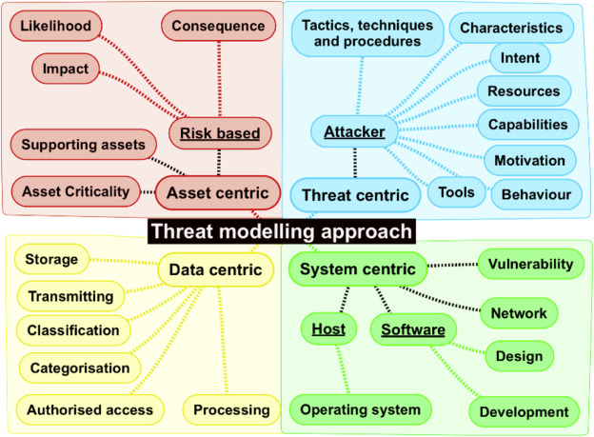
Threat Modelling: Approaches
A review of threat modelling approaches for APT-style attacks - ScienceDirect
Notes:
There are 4 recognised approaches to modelling threats :
The first, is an approach that focuses on individual account, system and/or data that has a value to the attacker. It is the target the attacker requires to compromise to complete their objective, and it is the asset that requires protection.
The second, a system or software-centric threat modelling, begins with an architectural design model of a system and its software. It focuses on identifying all components and their possible related attack vectors.
The third is a draft publication published by NIST. This publication examines data-centric system threat modelling, which is threat modelling that is focused on protecting particular types of data within systems.
The threat-centric or attacker-centric is the last approach and its efforts concentrate on evaluating the attackers target, and attempts to identify the possible vectors needed for to fulfil their objective.
Thes study in the link concluded that a hybrid approach to threat modelling is the best option to reduce the risk of APT's.

Slide 8
Threat Modelling: Asset-Centric
Process:
Identify high-value assets (e.g., databases, intellectual property, user credentials).
Determine the threats targeting those assets.
Analyse vulnerabilities that could be exploited.
Prioritise mitigation strategies based on asset criticality.
Example:
A bank identifies its customer transaction database as a critical asset.
Threats like SQL Injection, unauthorized access, and insider threats are analysed.
The bank strengthens database security with encryption, access control, and monitoring.
Strengths: Focuses on protecting the most valuable assets and helps organisations allocate security resources effectively.
Weaknesses: May overlook threats that do not directly target critical assets.

Slide 9
Threat Modelling: Attacker-Centric
Process:
Identify potential attackers (e.g., script kiddies, nation-state actors, insiders).
Define their motives, capabilities, and attack vectors.
Map out possible attack paths and weak points.
Develop mitigation strategies to counterattack methods.
Example:
A government agency assesses nation-state attackers targeting sensitive communications.
Attack vectors like phishing, malware, and supply chain attacks are identified.
Countermeasures such as zero-trust security and endpoint detection are implemented.
Strengths: Helps organisations stay ahead of evolving threats and improves understanding of attacker behaviours.
Weaknesses: Requires constant updates as attackers change tactics and can be resource-intensive.

Slide 10
Threat Modelling: System-Centric
Process:
Create a data flow diagram to visualise system components and interactions.
Identify entry points and trust boundaries within the system.
Assess security risks at each component level.
Implement security controls to strengthen weak areas.
Example:
A cloud service provider maps out its multi-tenant infrastructure.
Security concerns like data isolation, API security, and access controls are identified.
Measures like encryption, role-based access control, and network segmentation are applied.
Strengths: Provides a structured security assessment of an entire system. Useful for designing secure software architectures.
Weaknesses: May not consider external attackers' motivations. Requires deep technical knowledge of system architecture.

Slide 11
Threat Modelling: Data-Centric
Process:
Identify sensitive data: Determine what data needs protection (e.g., PII, financial records, intellectual property).
Map the data flow: Track where data is stored, processed, and transmitted.
Identify threats: Assess risks like unauthorised access, data leaks, ransomware, and insider threats.
Apply security controls: Implement encryption, access controls, data masking, and secure transmission methods.
Example:
A financial institution models threats to credit card transaction data.
Risks like data breaches, SQL Injection, and insider fraud are analysed.
Mitigation strategies: End-to-end encryption, tokenisation, and strict data access policies.
Strengths: Prioritises data protection, which is the primary target in most cyberattacks. Aligns with privacy regulations (e.g., GDPR, CCPA, HIPAA)
Weaknesses: May overlook broader system vulnerabilities that lead to data exposure. Requires continuous monitoring of data movement and access.

Slide 12
Threat Modelling: Techniques
STRIDE (Spoofing, Tampering, Repudiation, Information Disclosure, Denial of Service, Elevation of Privilege)
OCTAVE (Operationally Critical Threat, Asset, and Vulnerability Evaluation)
DREAD (Damage, Reproducibility, Exploitability, Affected Users, Discoverability)
PASTA (Process for Attack Simulation and Threat Analysis)
Attack Trees (Hierarchical attack representation)
CVSS (Common Vulnerability Scoring System )
LINDDUN (Linkability, Identifiability, Nonrepudiation, Detectability, Disclosure of information, Unawareness, Noncompliance)
Persona non Grata
Security Cards
Notes:
https://www.sciencedirect.com/science/article/pii/S2405844021000748
https://insights.sei.cmu.edu/blog/threat-modeling-12-available-methods/
UK Gov examples: https://www.gov.uk/government/publications/secure-connected-places-playbook-documents/conducting-a-stride-based-threat-analysis

Slide 13
Threat Modelling: STRIDE
STRIDE was designed to help people developing software identify possible threats the software might face.
STRIDE is based on two steps
Model the in-place system by building data flow diagrams (DFDs) and identifying system entities, events, and boundaries of the system.
Find threats using a general set of known threats (STRIDE: Spoofing identity, Tampering with data, Repudiation, Information disclosure, Denial of service, and Elevation of privilege).
STRIDE’s main issue is that the number of threats can grow rapidly as a system increases in complexity.
Notes:
https://learn.microsoft.com/en-us/previous-versions/commerce-server/ee823878(v=cs.20)?redirectedfrom=MSDN

Slide 14
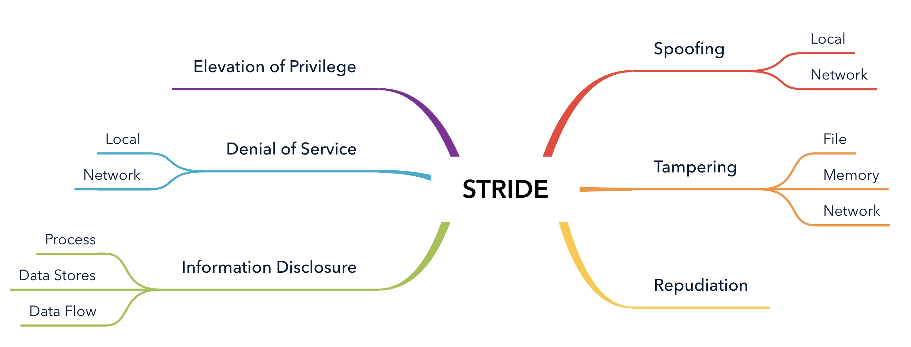
STRIDE Structure

Slide 15
STRIDE Overview
Threat | Property Violated | Definition | Example
Spoofing | Authentication | Impersonating something or someone else | Pretending to be any of Bill Gates, Paypal.com or ntdll.dll
Tampering | Integrity | Modifying data or code | Modifying a DLL on disk or DVD, or a packet as it traverses the network
Repudiation | Non-repudiation | Claiming to have not performed an action | “I didn’t send that email,” “I didn’t modify that file,” “I certainly didn’t visit that web site, dear!”
Information Disclosure | Confidentiality | Exposing information to someone not authorised to see it | Allowing someone to read the Windows source code; publishing a list of customers to a web site
Denial of Service | Availability | Deny or degrade service to users | Crashing Windows or a web site, sending a packet and absorbing seconds of CPU time, or routing packets into a black hole.
Elevation of Privilege | Authorisation | Gain capabilities without proper authorisation | Allowing a remote internet user to run commands is the classic example, but going from a limited user to admin is also EoP.

Slide 16
STRIDE Example
Company: Health care insurance provider.
Object in the scope of threat modelling: The company is in the process of developing a new web application called ‘MyHealth’. It will allow customers to view their medical data, billing, appointments with healthcare providers, and potential deals that customers can purchase.
Scoping limitations: Tthe business processes related to the MyHealth application are not in scope.
Tech stack of the application: The MyHealth web application will be cloud-based, hosted in Azure, and will have a Javascript framework front-end.
Team: Various DevOps teams are involved in the project, as well as business driving the transformation to provide as many health insurance services through the newly developed MyHealth application.
STRIDE Threat Modeling Example for Better Understanding and Learning - Threat-Modeling.com
Notes:
https://www.gov.uk/government/publications/secure-connected-places-playbook-documents/conducting-a-stride-based-threat-analysis
https://www.bing.com/videos/riverview/relatedvideo?q=STRIDE+eample&mid=B00A725FC5D3A551115DB00A725FC5D3A551115D&FORM=VIRE
The development of the application will connect to various parts of the IT landscape which is considered legacy, and thus not in scope of the current threat modelling case.
The above description is meant to provide you with a general idea of the business case, development environment, and tech stack used in this STRIDE threat modeling example.

Slide 17
STRIDE Example
First Step: Gather background information
Architectural diagrams and overviews of the proposed application design,
Requirements of the solution,
Project documentation,
Team overview and governance.

Slide 18
STRIDE Example
Second Step: Create a Data Flow Diagram (DFD)
Include key components of the system/solution,
including too much information can make the overall threat model too complicated and too difficult to understand.
It is important to get the DFS input and cooperation from a wide range of team members, including technical/non-technical, developers/non-developers, testers, Product Owners, and any other people and roles with knowledge of the application.

Slide 19
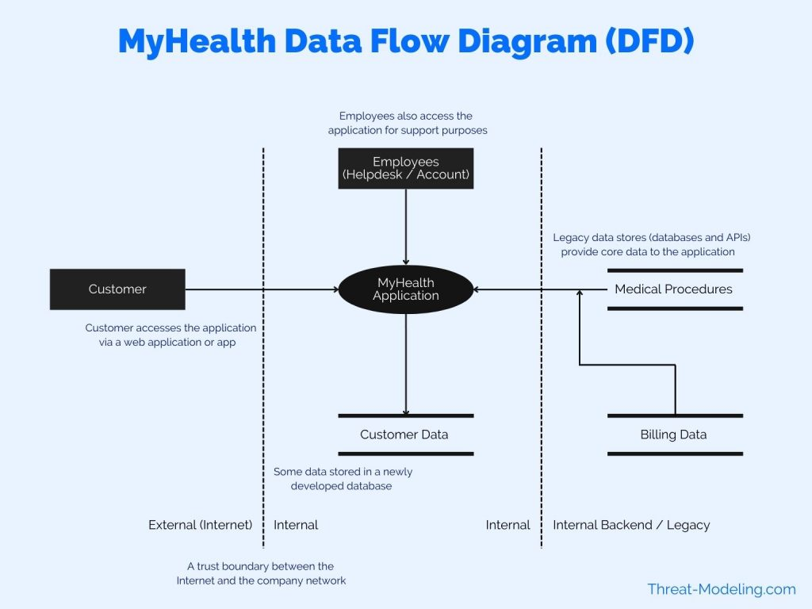
STRIDE Example
Notes:
Customer: The end customer using the application. The customer is a health insurance recipient (paying a monthly health insurance fee, and receiving health insurance coverage).
Employees: Employees access the application as well as customers. Employees provide support to customers via a helpdesk and other channels. Employees can see more data than customers, including access to many different customers.
MyHealth Application: This is the main application in the scope of the threat modelling exercise. It is shown here as one icon. However, the application has many sub-components, backend, frontend, etc.
Customer Data: The new application will have a new database environment to store some of the relevant customer data.
Medical Procedures (and activities): Data provided to the customer includes medical procedures, activities, etc. This data is stored in a legacy database and system. This data will not be sent to the Customer Data database.
Billing Data: Billing data is managed in a separate system, but is shown via the MyHealth application (to the customer).

Slide 20
STRIDE Example
Third Step: Perform Component Based STRIDE Threat Modelling
STRIDE threat modelling against each component,
Two approaches for this step:
Think of potential threats per component, and assign a STRIDE threat type (i.e., assign Spoofing, or Tampering, etc.).
Per component, think of Spoofing threats specifically, then Tampering threats, then Repudiation threats, etc. So, in order of STRIDE, go through the list and think of potential threats limited to the STRIDE threat type.
You can combine the two approaches

Slide 21
STRIDE on the MyHealth Application Component
STRIDE | Identified Threats
Spoofing | Spoofing Theat 1: A user could possibly access data from other users. There are lots of sources of data that are shared within the MyHealth application. There are also lots of features within the application that access different parts of the data. Spoofing Threat 2: The application needs to be accessible to customers. Therefore, the login feature, and its related features (i.e., password reset, etc.), need to be easy to use. However, the ease of use must not introduce a threat which allows an attacker to circumvent or misuse login features (and thus gain access to user credentials).
Tampering | Tampering Threat 1: The application has limited data entry features, because most of the features are read-only. For example, users cannot edit billing data, or edit registered medical procedures. But some core informaton about the user can be edited, such as current address, which bank account or credit card must be used, etc. There is a potential threat of other people, except for the current user, tampering with user data.
Repudiation | No Repudiation threats identified.
Information Disclosure | Information Disclosure Threat 1: Medical data is extremely confidential, and subject to various regulations (i.e., HIPAA). There is a threat that users may access medical data of other users, through lack of access controls. Information Disclosure Threat 2: There is a potential threat of employees accessing health data inappropriately via the MyHealth application (other applications already have strict controls). Information Disclosure Threat 3: There is a threat that attackers, may target customers to try and gain access to their data. Think phishing attacks against our customers, social engineering, etc..
Denial of Service | Denial of Service Threat 1: The application has very high Availability requirements. There is a threat that criminal gangs will target the company with DDoS attacks. The company has been a target of such attacks in the past.
Elevation of Privilege | No Elevation of Privilege threats identified.

Slide 22
STRIDE on the Customer Data Component
TRIDE | Identified Threats
Spoofing | No Spoofing threats identified.
Tampering | Tampering Threat 1: A database administrator may tamper with customer data for fraud purposes. Tampering Threat 2: Someone who gains unauthorised access to the database may tamper with customer data.
Repudiation | No Repudiation threats identified.
Information Disclosure | Information Disclosure Threat 1: An attacker may infiltrate the company network, and gain access to the database, and then have access to all database data.
Denial of Service | No DoS threats identified.
Elevation of Privilege | Elevation of Privilege Threat 1: A database configuration page may be exposed on the internal network, which could be used to gain unauthorised access to the database. Elevation of Privilege Threat 2: A default database user may be used to gain access to the database, if the login method is exposed to the internal company network (and not only accessible on a separate management network).

Slide 23
Threat Modelling: OCTAVE
OCTAVE was developed by Software Engineering Institute (SEI) at Carnegie Mellon University.
OCTAVE is a flexible and self-directed risk assessment methodology that focuses on organisational risk assessment rather than just technical vulnerabilities. It's particularly well-suited for enterprise-level threat modelling.
OCTAVE is designed to allow an organisation to:
Direct and manage information security risk assessments for themselves
Make the best decisions based on their unique risks
Focus on protecting key information assets
Effectively communicate key security information
Notes:
https://insights.sei.cmu.edu/library/introduction-to-the-octave-approach/
https://insights.sei.cmu.edu/documents/17/2001_012_001_51564.pdf

Slide 24
OCTAVE
The intended audience for the OCTAVE method is large organisations with 300 or more employees.
More specifically, it was designed for organisations that
have a multi-layered hierarchy
maintain their own computing infrastructure
have the ability to run vulnerability evaluation tools
have the ability to interpret the results of vulnerability evaluations

Slide 25
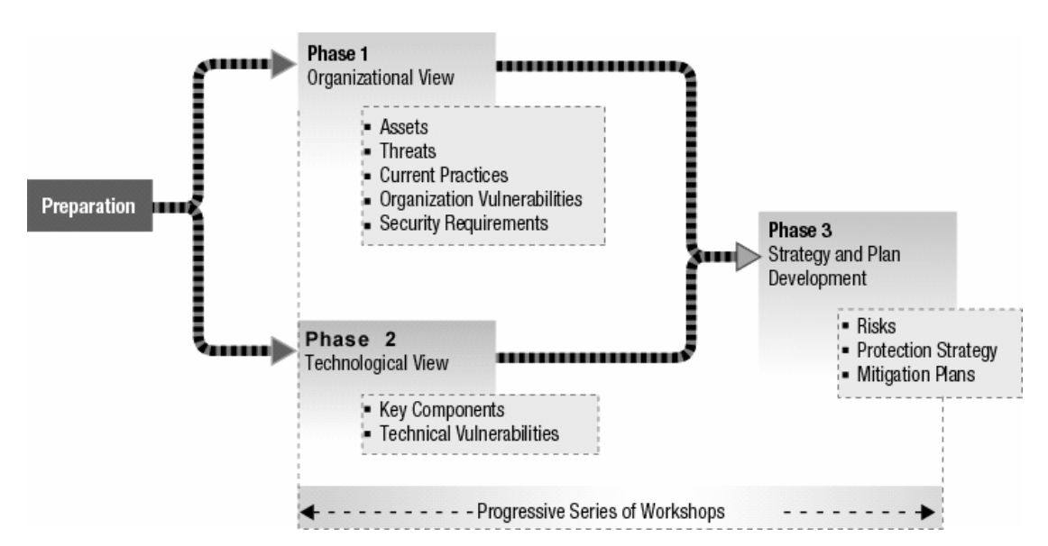
OCTAVE Structure
OCTAVE method is based on eight processes that are broken into three phases to examine organisational and technology issues.
Phase 1: Build Asset-Based Threat Profiles. This is an organisational evaluation. The analysis team determines which assets are most important to the organisation (critical assets) and identifies what is currently being done to protect those assets.
Process 1: Identify Senior Management Knowledge – Selected senior managers identify important assets, perceived threats, security requirements, current security practices, and organizational vulnerabilities.
Process 2: Identify Operational Area Management Knowledge – Selected operational area managers identify important assets, perceived threats, security requirements, current security practices, and organisational vulnerabilities.
Process 3: Identify Staff Knowledge – Selected general and IT staff members identify important assets, perceived threats, security requirements, current security practices, and organisational vulnerabilities.
Process 4: Create Threat Profiles – The analysis team analyses the information from Processes 1 to 3, selects critical assets, refines the associated security requirements, and identifies threats to those assets, creating threat profiles.

Slide 26
OCTAVE Structure
Phase 2: Identify Infrastructure Vulnerabilities – This is an evaluation of the information infrastructure. The analysis team examines key operational components for weaknesses (technology vulnerabilities) that can lead to unauthorised action against critical assets.
Process 5: Identify Key Components – The analysis team identifies key information technology systems and components for each critical asset. Specific instances are then selected for evaluation.
Process 6: Evaluate Selected Components – The analysis team examines the key systems and components for technology weaknesses. Vulnerability tools (software, checklists, scripts) are used. The results are examined and summarised, looking for the relevance to the critical assets and their threat profiles.

Slide 27
OCTAVE Structure
Phase 3: Develop Security Strategy and Plans – During this part of the evaluation, the analysis team identifies risks to the organisation’s critical assets and decides what to do about them.
Process 7: Conduct Risk Analysis – The analysis team identifies the impact of threats to critical assets, creates criteria to evaluate those risks, and evaluates the impacts based on those criteria. This produces a risk profile for each critical asset.
Process 8: Develop Protection Strategy – The analysis team creates a protection strategy for the organisation and mitigation plans for critical assets, based upon an analysis of the information gathered. Senior managers then review, refine, and approve the strategy and plans.

Slide 28
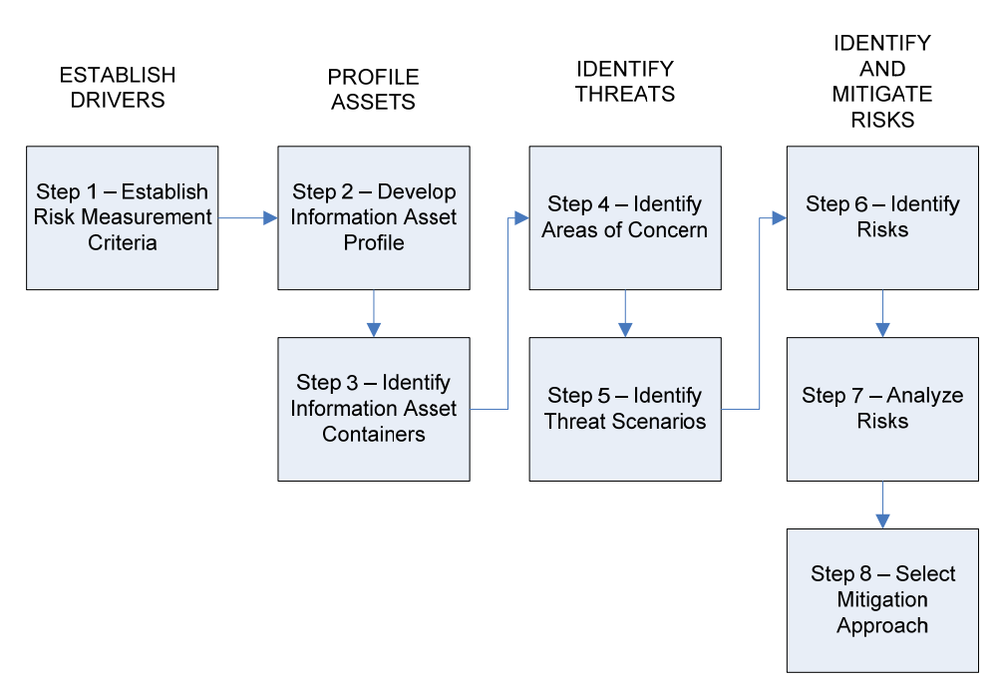
OCTAVE Allegro Roadmap
This approach focuses primarily on information assets in the context of how they are used, where they are stored, transported, and processed, and how they are exposed to threats, vulnerabilities, and disruptions as a result.
OCTAVE Allegro is well suited for use by individuals who want to perform risk assessment without extensive organisational involvement, expertise, or input.
Notes:
The OCTAVE Allegro approach consists of eight steps that are organised into four phases, as illustrated in the figure.
In phase 1, the organisation develops risk measurement criteria consistent with organisational drivers.
During the second phase, information assets that are determined to be critical are profiled. This profiling process establishes clear boundaries for the asset, identifies its security requirements, and identifies all of the locations where the asset is stored, transported, or processed.
In phase 3, threats to the information asset are identified in the context of the locations where the asset is stored, transported, or processed.
In the final phase, risks to information assets are identified and analysed and the development of mitigation approaches is commenced.

Slide 29
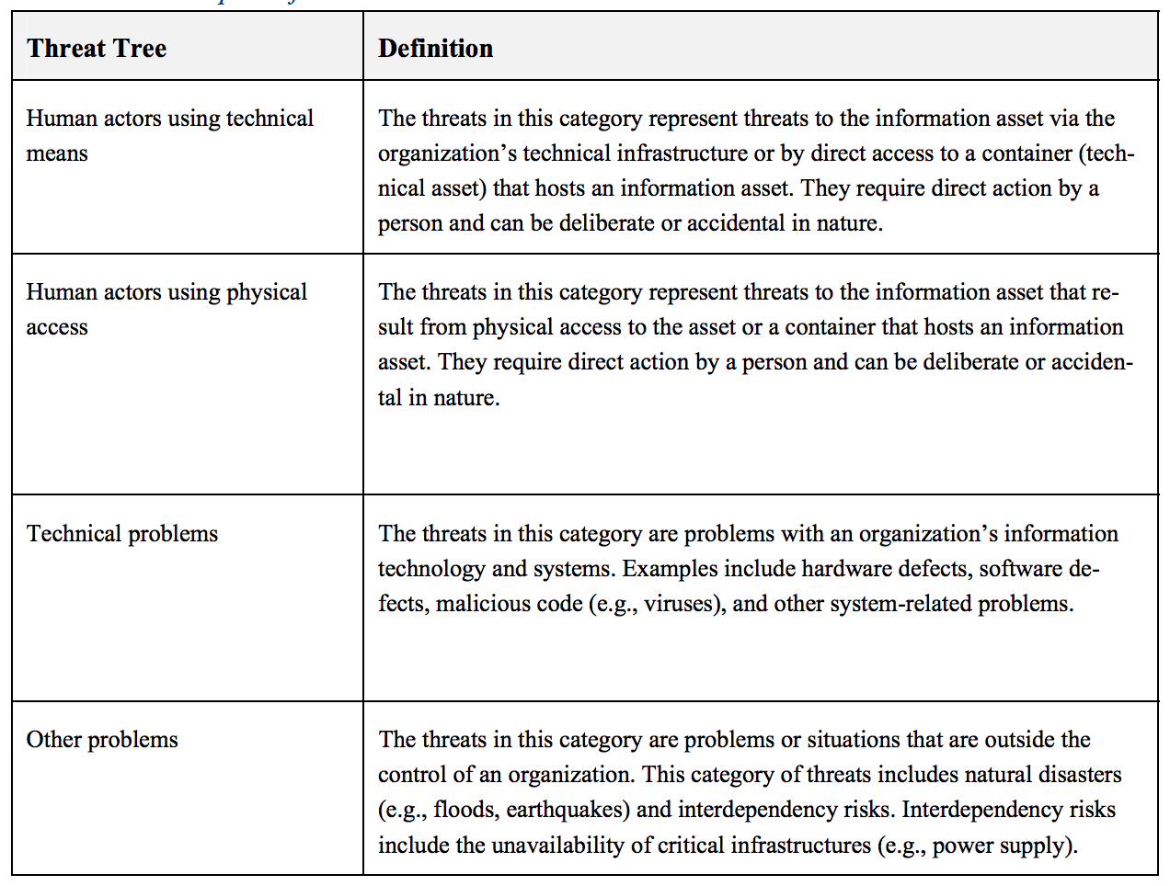
OCTAVE Allegro: Threat Trees
A range of threat scenarios can be represented visually in a tree structure commonly referred to as a threat tree.
Notes:
In the first half of Step 5, the areas of concern captured in the previous step are expanded into threat scenarios that further detail the properties of a threat. But the collection of threats developed from these areas of concern does not necessarily provide a robust consideration of possible threats to an organization’s information asset. Thus, in the second half of Step 5, a broad range of additional threats is considered by examining threat scenarios.

Slide 30
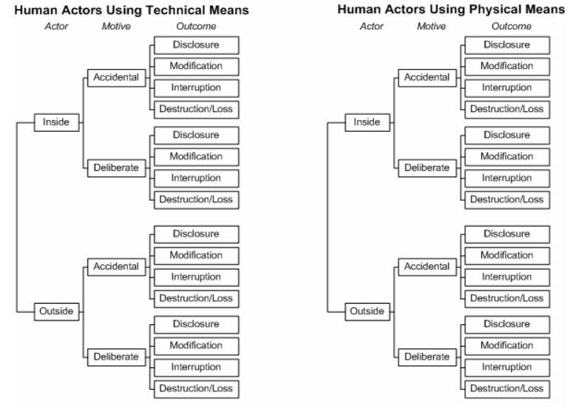
Graphical Representation of Threat Trees

Slide 31
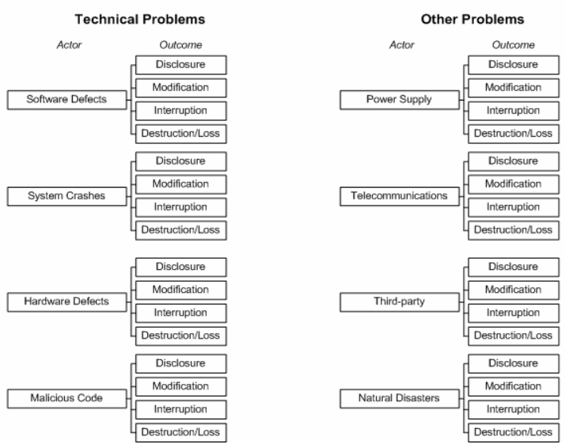
Graphical Representation of Threat Trees

Slide 32
OCTAVE Allegro: Threat Trees
The threat scenario derived from areas of concern corresponds to a branch on these threat trees.
To ensure a robust consideration of threats, each branch of the threat tree should be considered for an information asset.
A series of threat scenario questionnaires have been developed and are provided to help you with this task.
More information: https://resources.sei.cmu.edu/asset_files/TechnicalReport/2007_005_001_14885.pdf

Slide 33
Next Week
Other Threat Modelling Techniques

